Slide 1
SA420-NATURAL RESOURCE ECONOMICS
LECTURER NAME:
MULENGA MPOLOKOSO
(Ph.D_WIP, MBA, BBA, BICTED, BSCFO, TM, ISP, CMP)

Slide 2
TOPIC 5: ACCOUNTING FOR INFLATION IN FINANCIAL ANALYSIS
OUTLINE OF THE TOPIC
Definition of Inflation
Types of Inflation
Measuring Inflation
Calculating Inflation Rate
Deflated and Inflated values
Nominal and Real Dollar Values
Real and Nominal Rates of Return

Slide 3
INFLATION CONT…
DEFINITION
Inflation is the broad rate of increase in prices over a given period, leading to a decline in the purchasing power of money.
1. Measuring Inflation (Consumer Price Index - CPI)
The CPI tracks the cost of a "market basket" of goods and services.
CPI Formula:
Inflation Rate Formula

Slide 4
INFLATION
Demand-Pull Inflation: Occurs when demand for goods exceeds supply (YOU HAVE HEAD A SAYING “too much money chasing too few goods").
Cost-Push Inflation: Driven by increases in production costs, such as wages or raw materials (e.g., oil prices).
Built-in Inflation: Linked to adaptive expectations; as prices rise, workers demand higher wages to maintain their standard of living, creating a cycle.

Slide 5
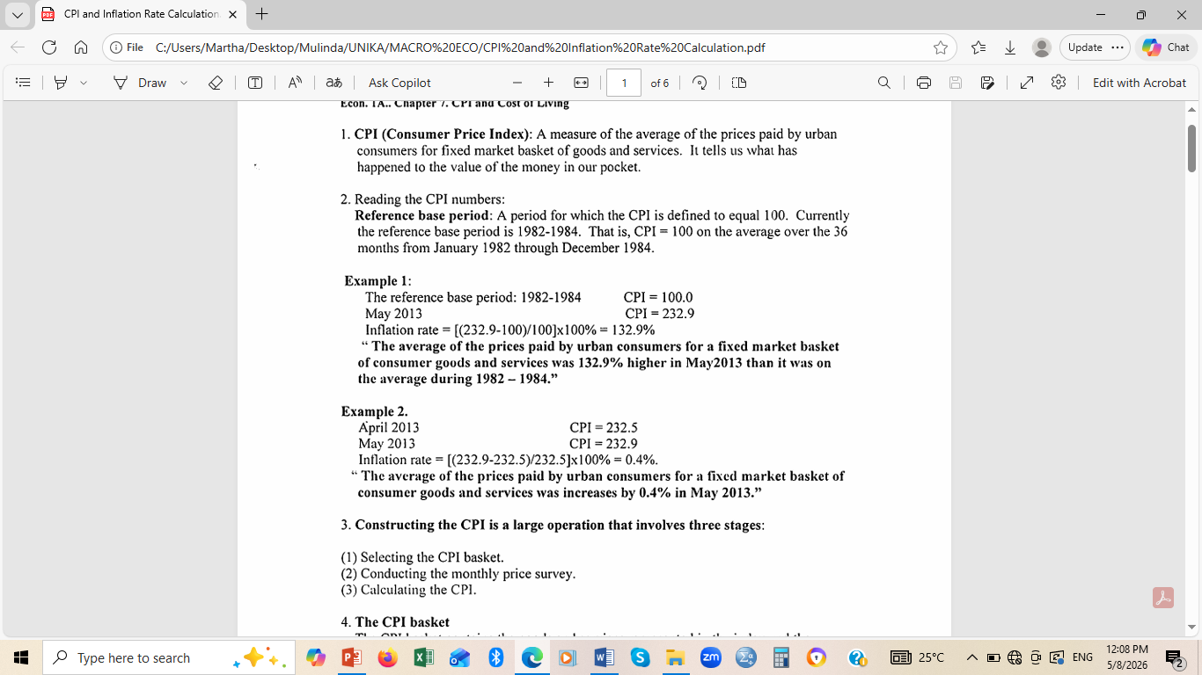
UNDERSTANDING CPI AND INFLATION

Slide 6
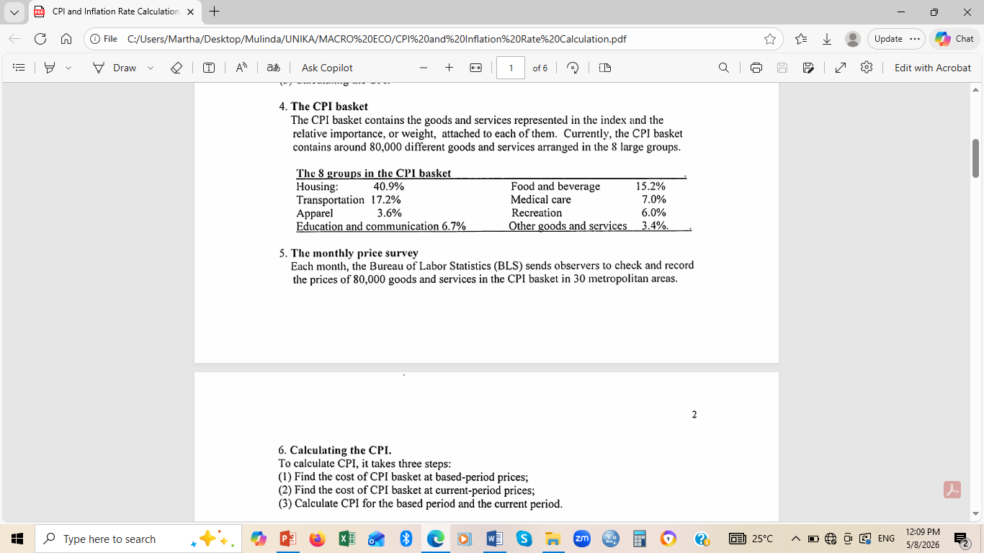

Slide 7
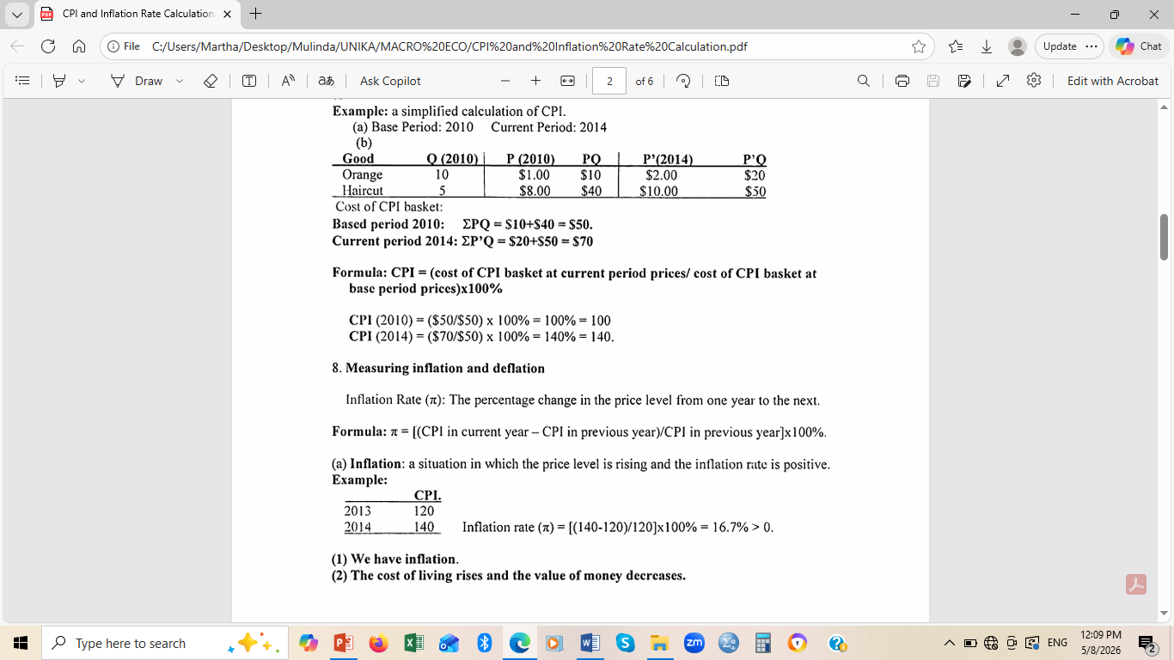

Slide 8
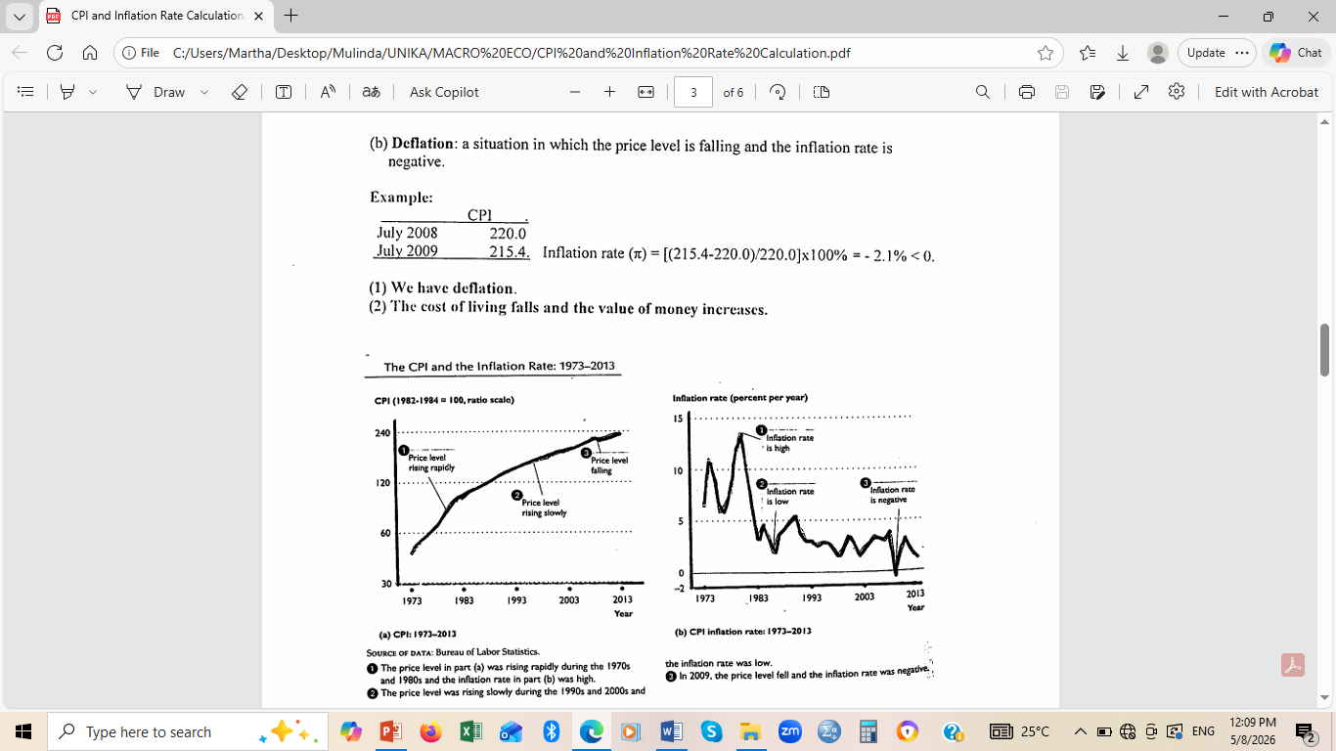

Slide 9
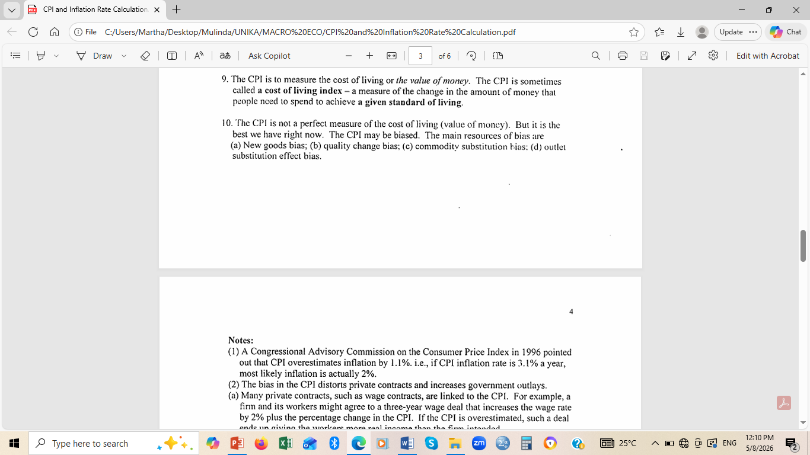

Slide 10
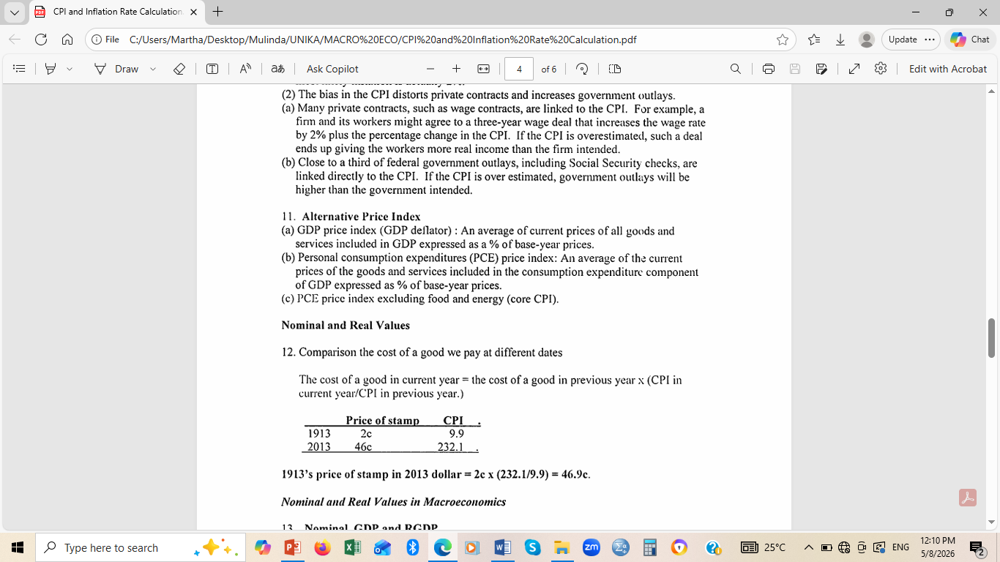

Slide 11
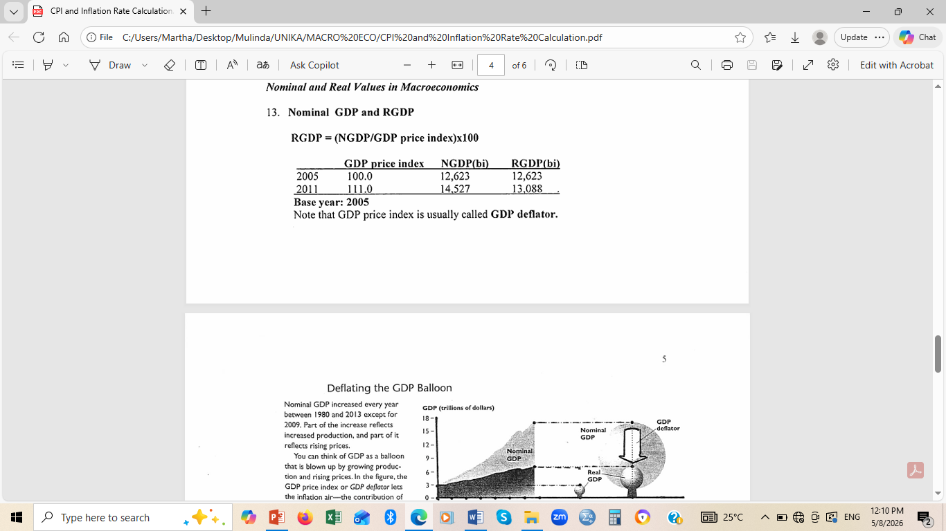

Slide 12
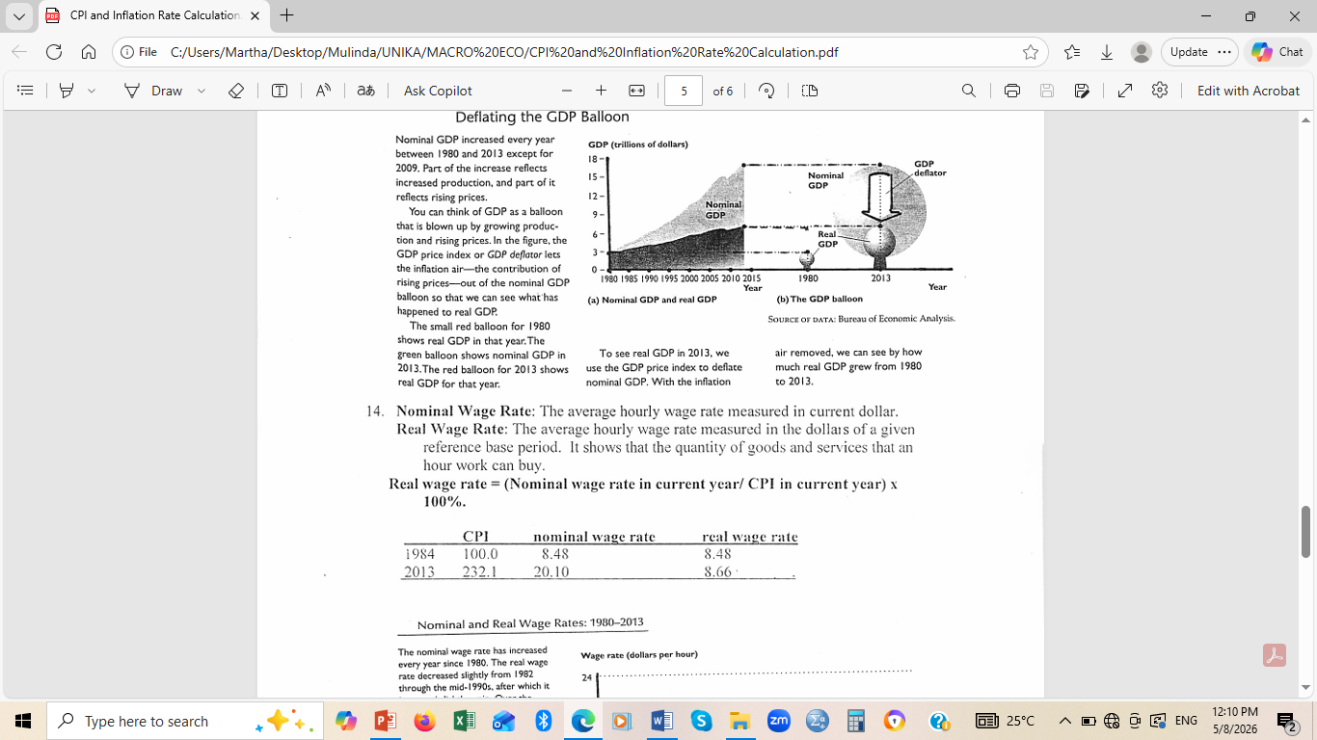

Slide 13
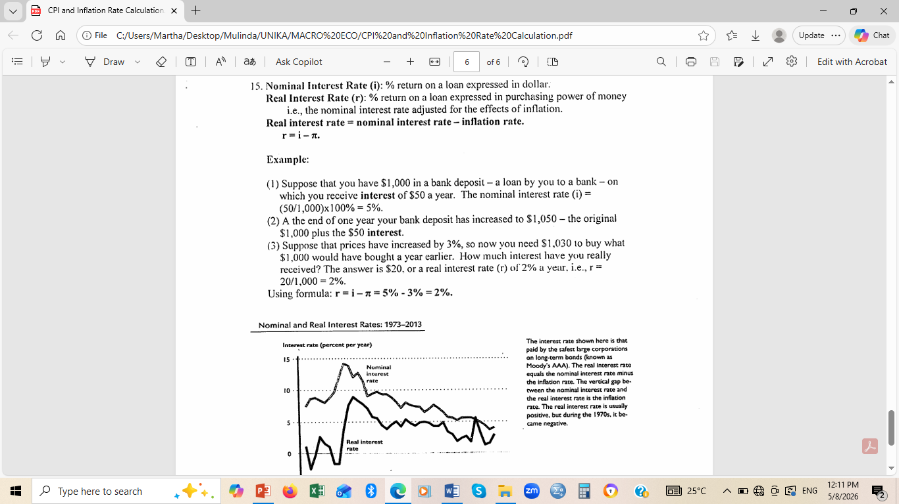

Slide 14
END OF LESSON

